Slide 1


HVAC Proposals
Jacob Dominski
University of Advancing Technology
Advancing Computer Science, SIP401

Slide 2
SIP Title & Innovation Claim
HVAC Proposals was created to help the HVAC Industry in automating their proposal forms while in the field.
Innovation Claim:
This project is innovative because it will change the way my clients do business and engage with their customers in a new and technological way.

Slide 3
Project Description & Individual Contribution
HVAC Proposals is a mobile app that aims to create a faster and more efficient workflow within my client’s company. My app is meant for the HVAC industry where a big portion of that industry still use pen and paper. My idea would let the technician create the proposal while on site to decrease the time taken to get the customer to agree to the job. This would increase workflow, efficiency, and productivity by approximately 25% – 30%.
I am the sole contributor to this project and will be handling 100% of the work.

Slide 4
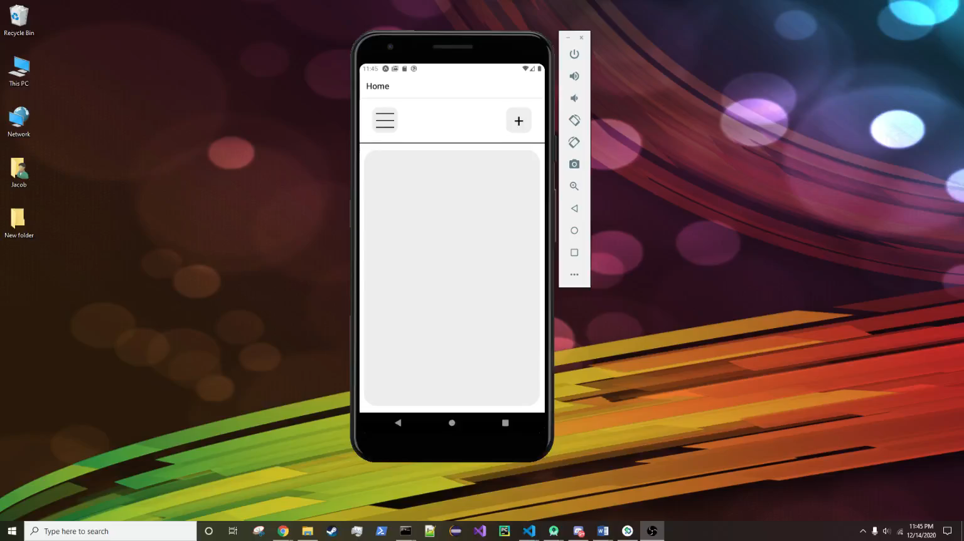
SIP Prototype Video

Slide 5
Q&A
Jacob Dominski – Advancing Computer Science
Innovation Claim: This project is innovative because it will change the way my clients do business and engage with their customers in a new and technological way.

